Slide 1
Our new Zero Energy home
Diane & John Burke

Slide 2
Agenda
5 Principles of Passive House
How is it working so far?
Living in it
Organic Garden& Native Plants
Q&A

Slide 3
5 Principles of Passive House
No Thermal Bridging
Walls, floors, and roofs are well insulated with no gaps. This reduces heating and cooling requirements.
Superior Windows
Windows are the biggest source of heat transfer. Triple Pane windows are more than twice as efficient as double pane.
Energy Recovery Ventilation
An ERV recovers heat from stale used air and transfers it to fresh incoming air. Heat Pumps are used for heating and cooling.
Quality Construction
Quality construction is key to successful accomplishment of objectives. Insulation serves to minimize heat transfer.
Air-Tight Construction
There should be no uncontrolled airflow between the external and internal environment.

Slide 4
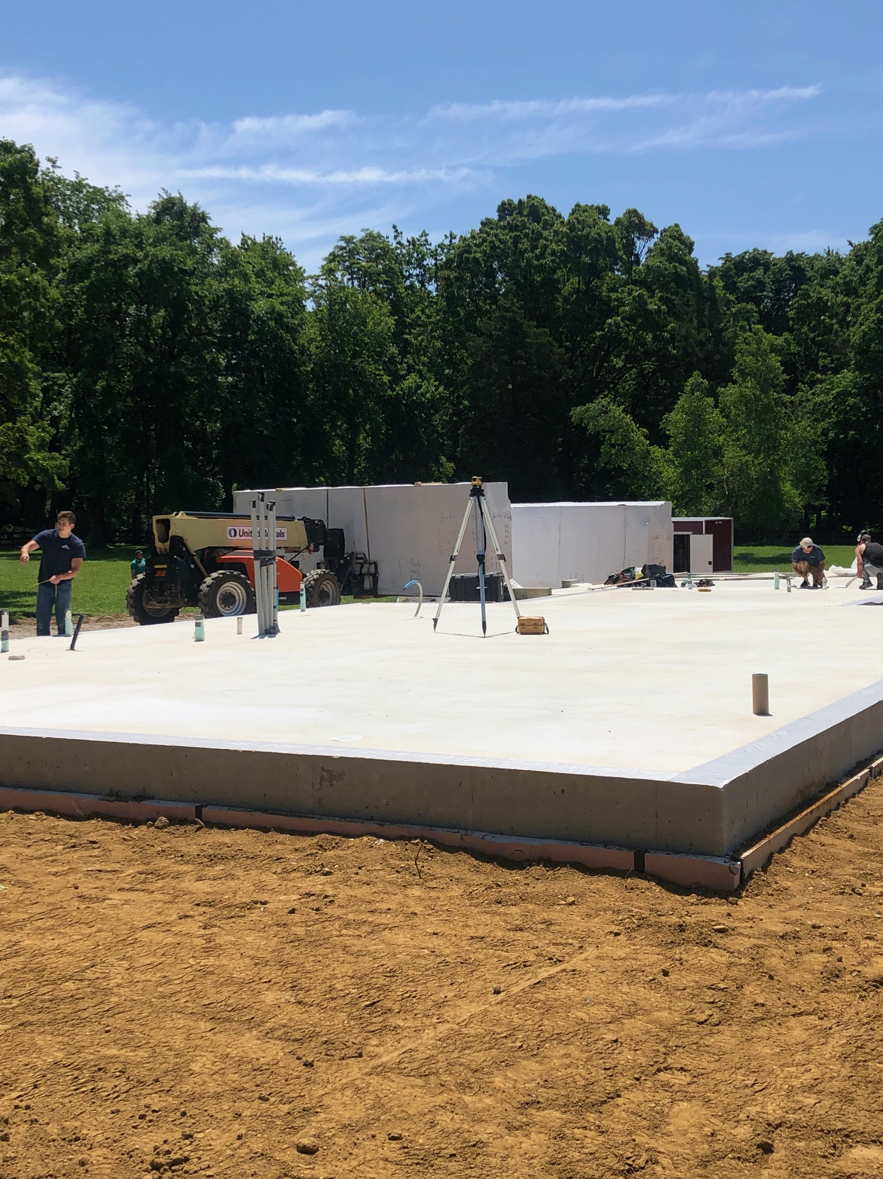
No Thermal Bridging
Walls 18” thick, Packed cellulose insulation
Foundation 5’ deep and insulated

Slide 5
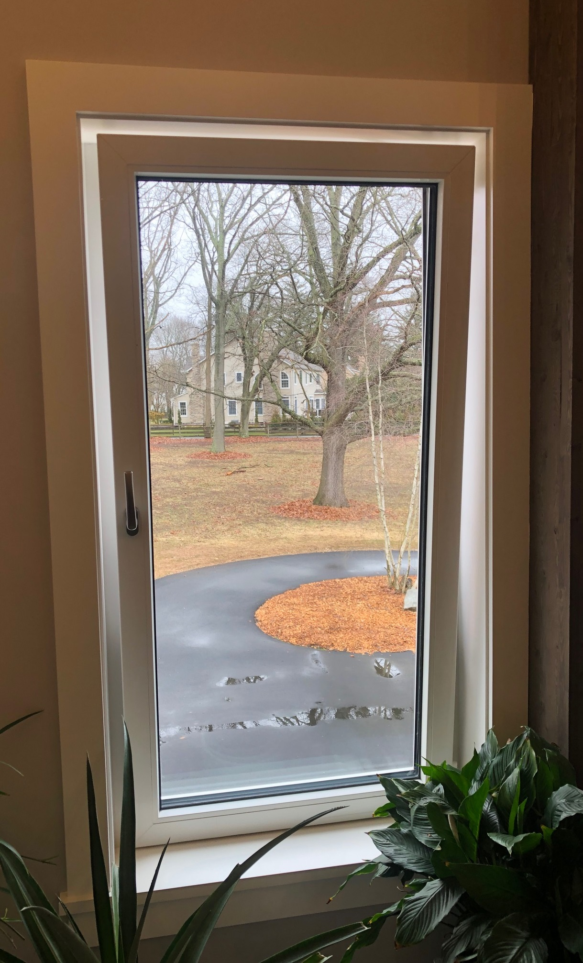
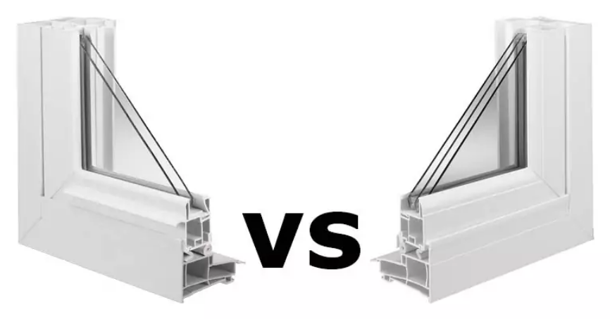
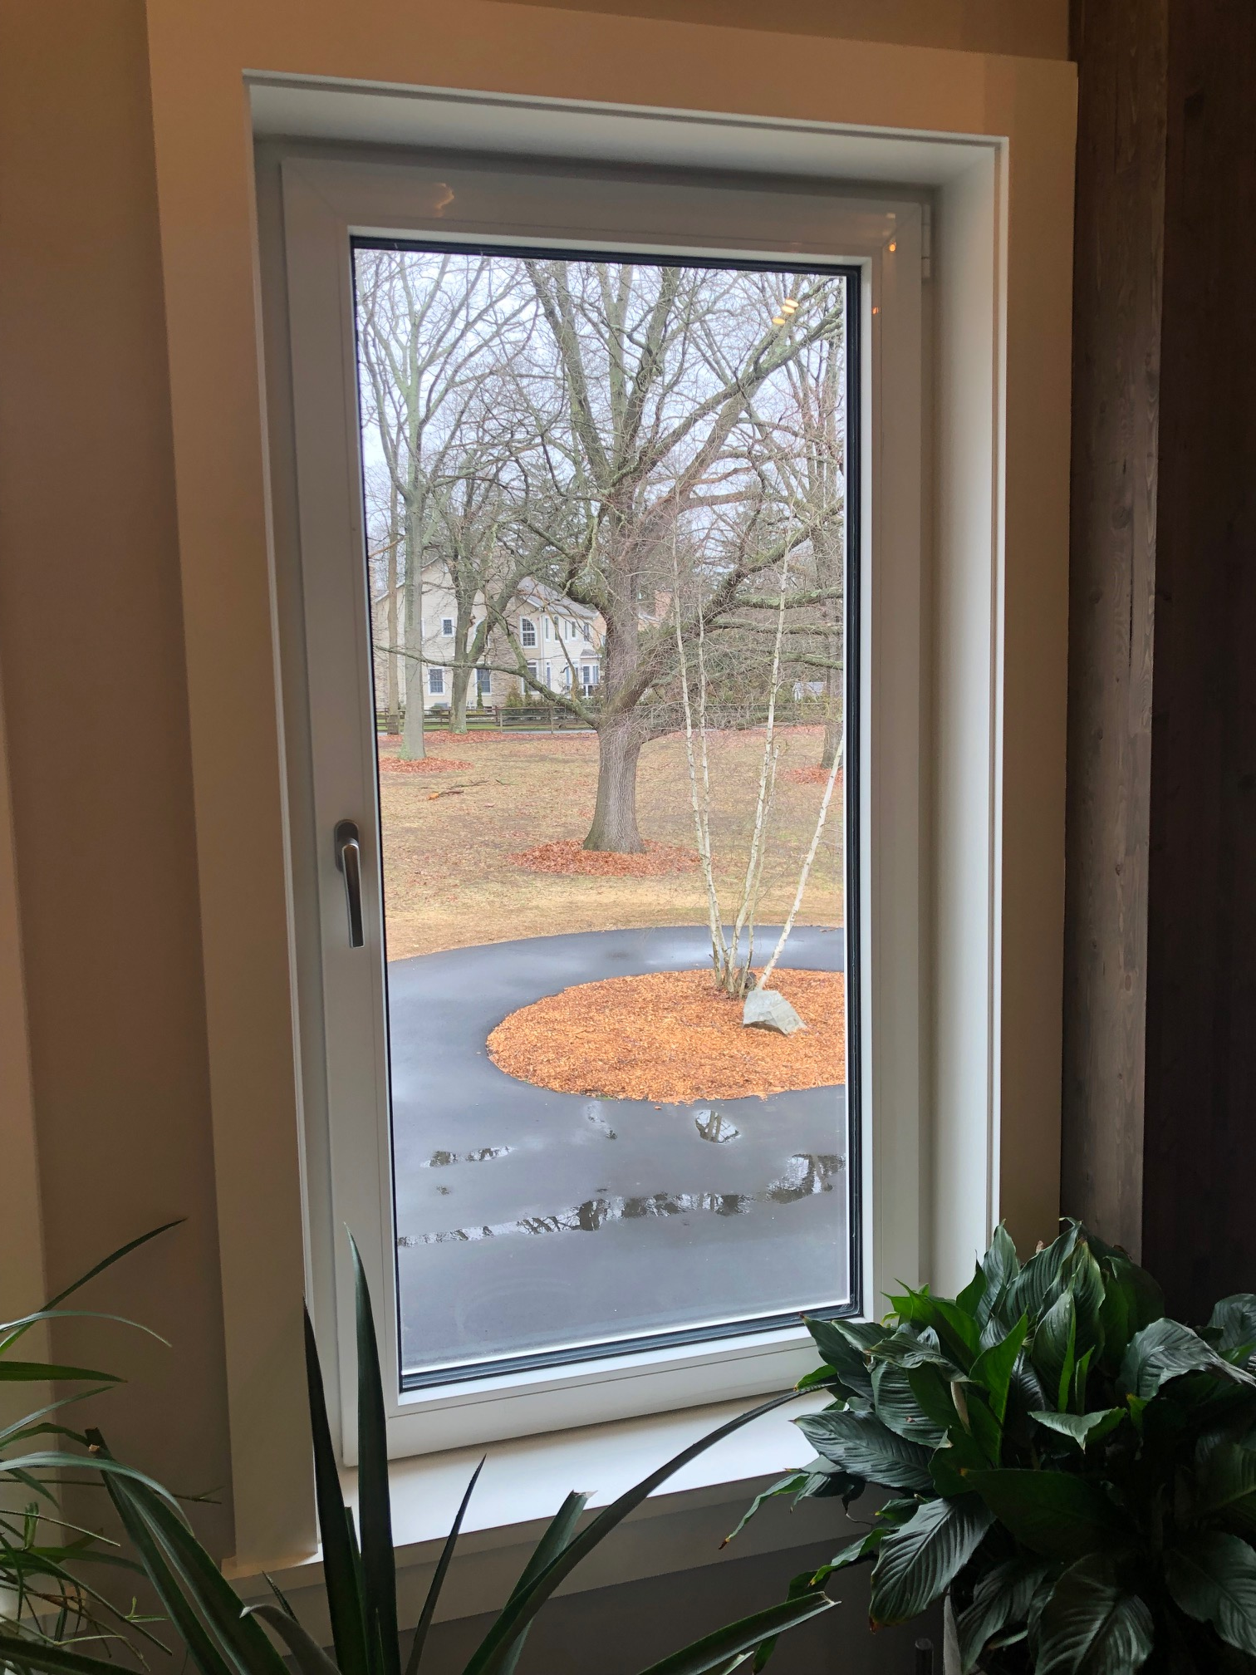
Superior Windows
Triple Pane Windows
Double Pane = 3.4 R value
Triple Pane = 7.5 R value

Slide 6
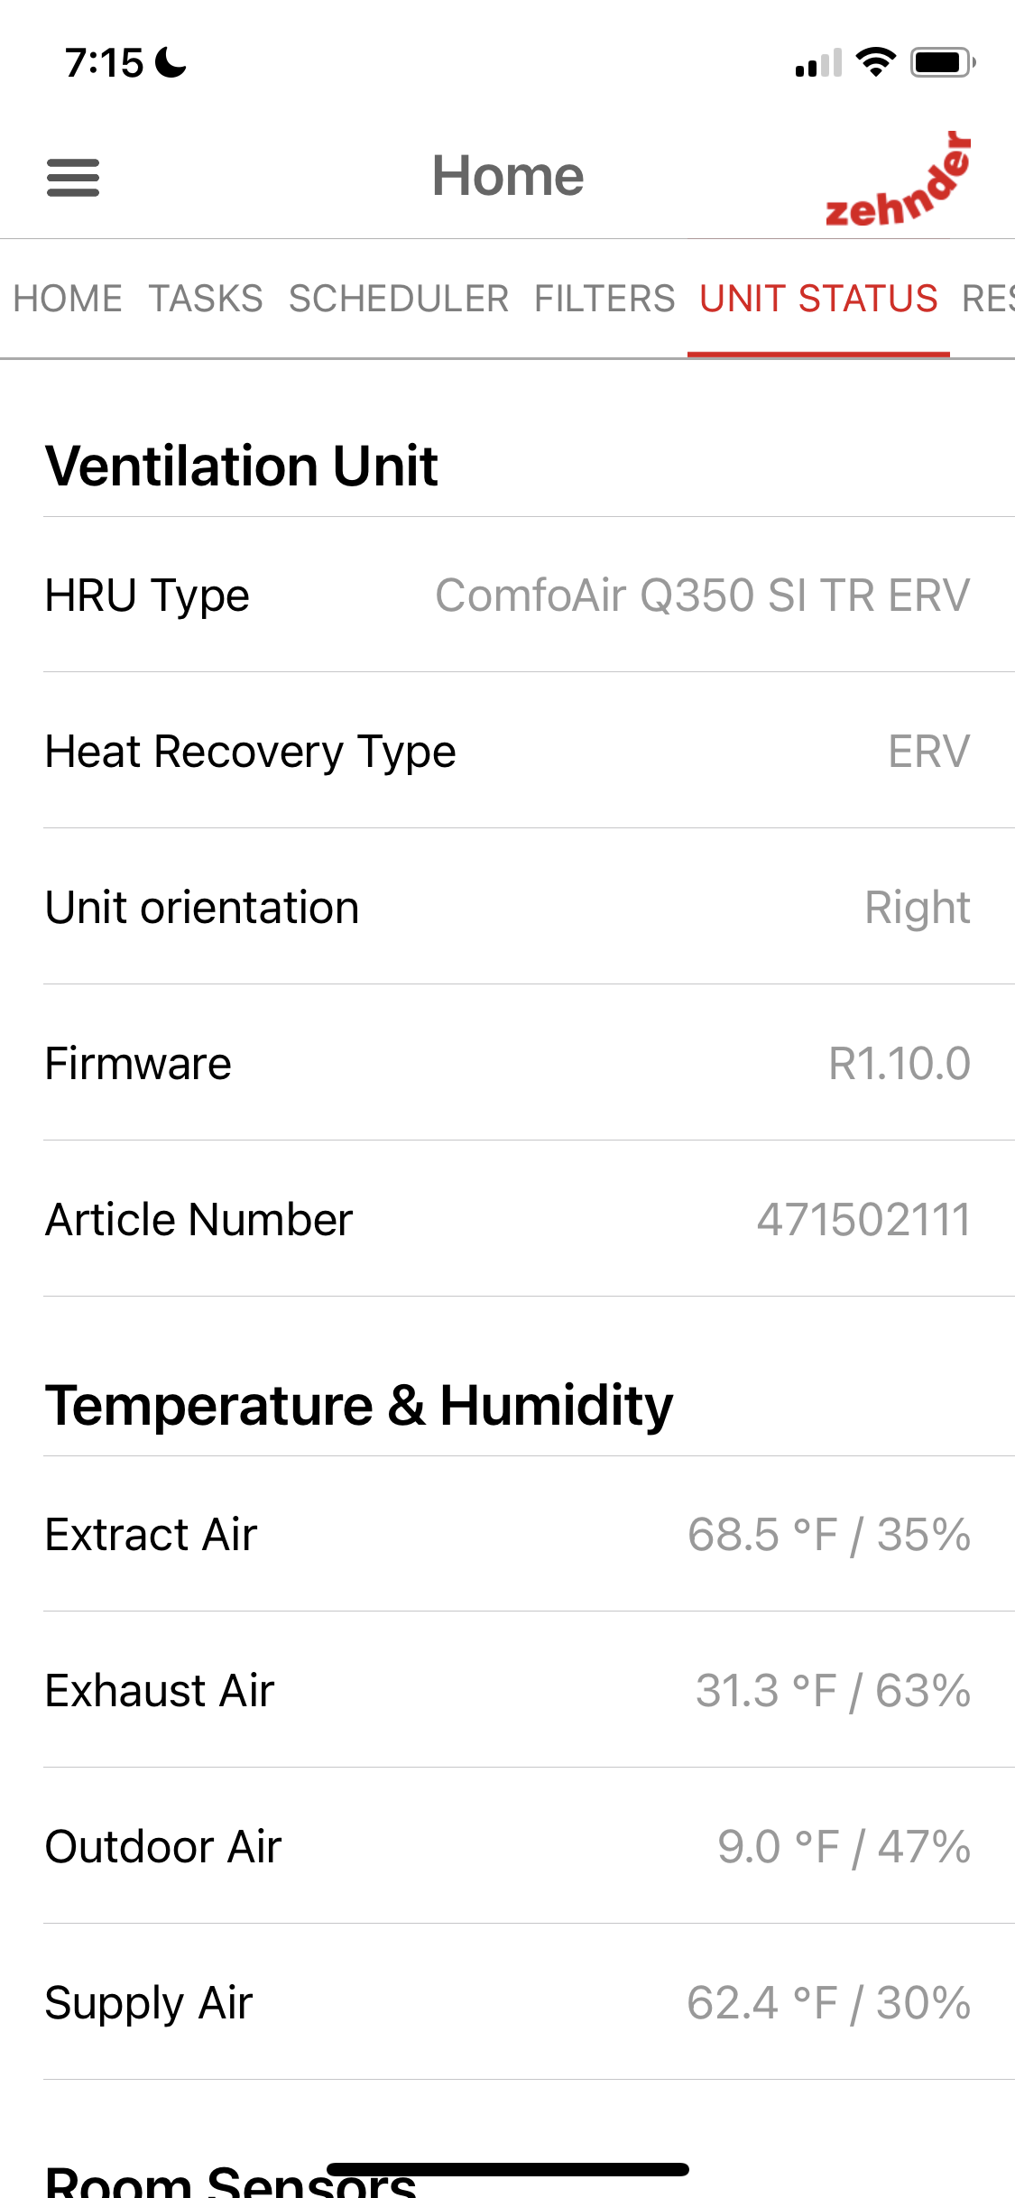
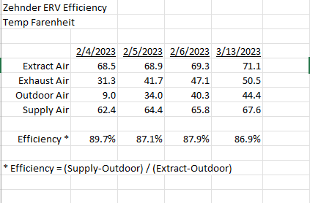
Energy Recovery Ventilation (ERV)
Zehnder ComfoAir
Zehnder App
ERV Efficiency
ERV unit
ERV recovers about 90% of heat/cool temp
Also controls humidity

Slide 7
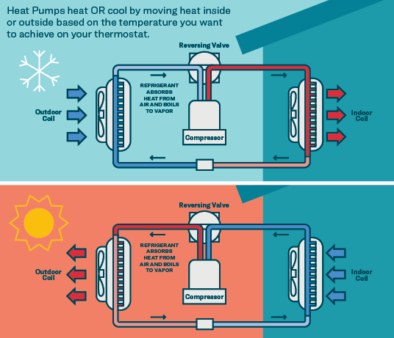
Heat Pumps
How Heat Pumps work
Heat Pumps are Electro-mechanical
No burning of carbon-based fuels
Not electric resistance (baseboard) heaters
Heats in winter, cools in summer
Based upon latent heat of evaporation and condensation

Slide 8
Quality Construction
Panels built in factory Minimal waste
Carefully assembled on site

Slide 9
Air-Tight Construction
Blower Door Test

Slide 10
How’s it working so far?
 | Passive Standard | Our House
Primary Energy Use | <= 60 kWh/M²/yr | 54.4 kWh/M²/yr
Airtightness | <= 0.60 ACH50 | 0.227 ACH50
Thermal Comfort | <= 10% > 25C (77F) | TBD, but I wouldn’t bet against it

Slide 11
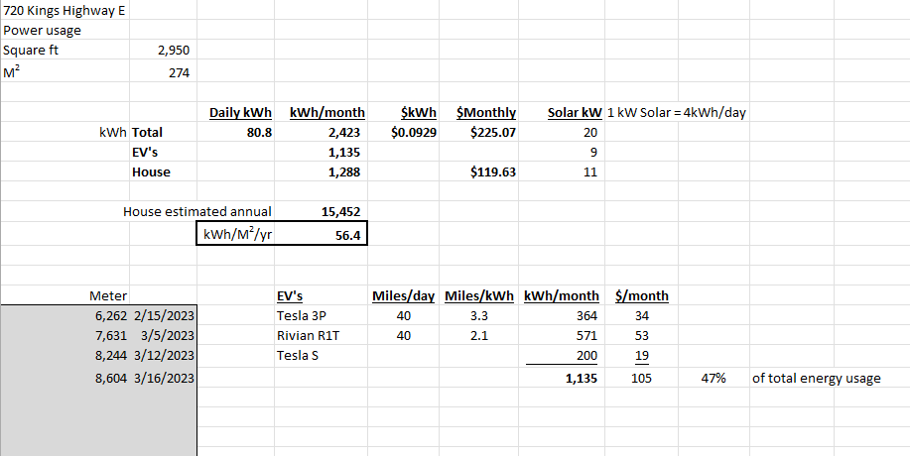
Estimated Energy Usage

Slide 12
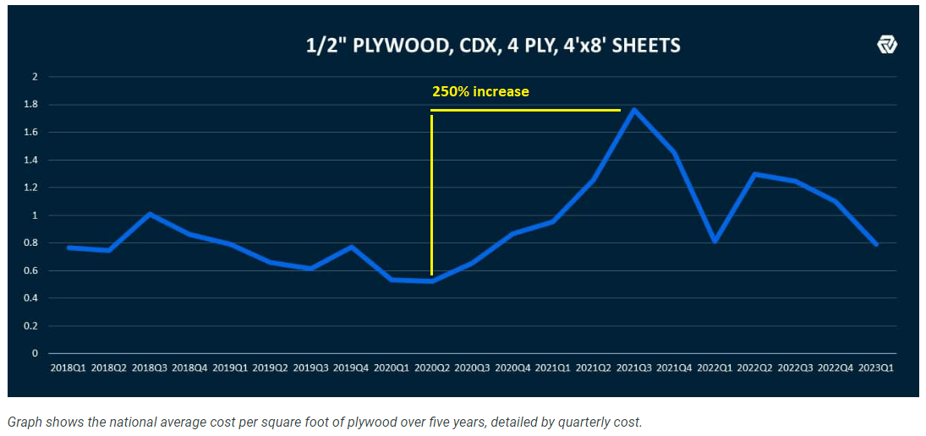
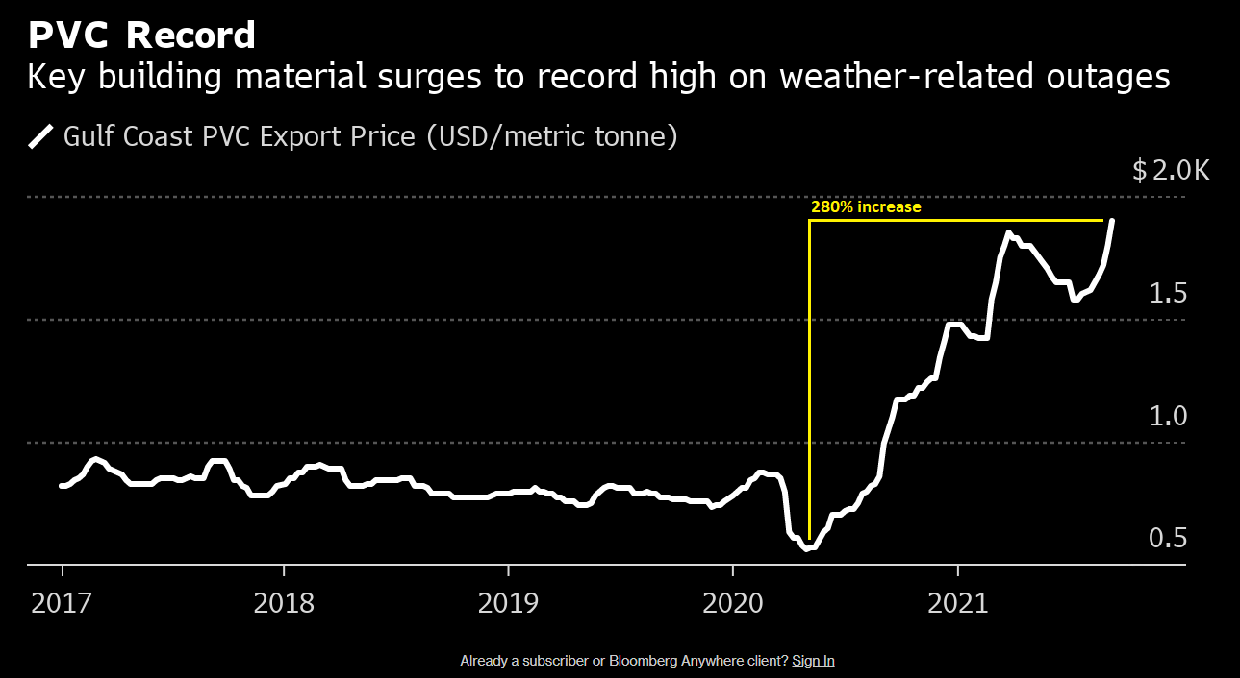
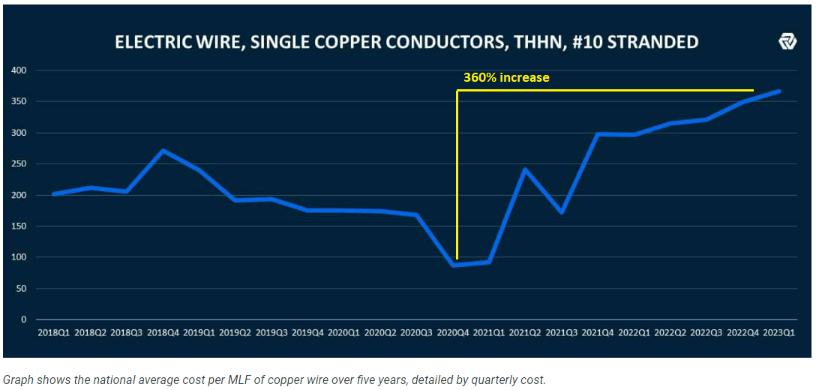
Problems and obstacles
Inflation! - Building materials are up a lot more than PCE,CPI
Variances and permits –Normal stuff...
Finding a Passive savvy General Contractor - Key
Can’t permeate thermal barrier
No basement
300 ft to power & new telephone pole and transformer

Slide 13
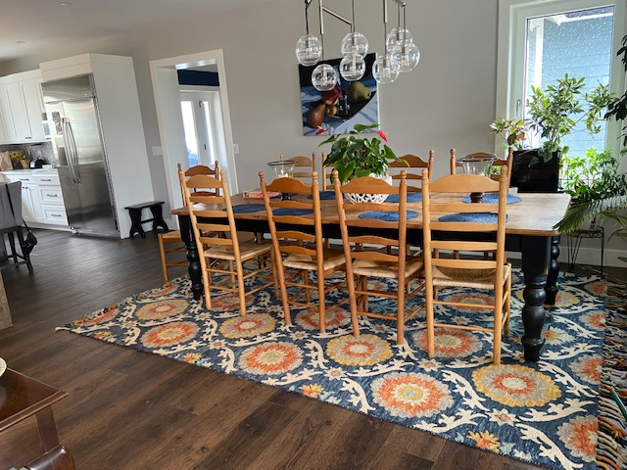
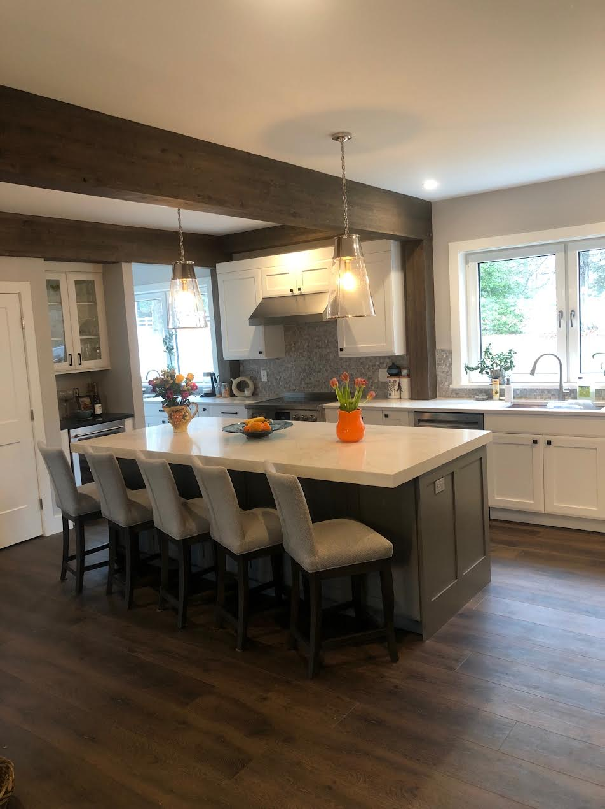
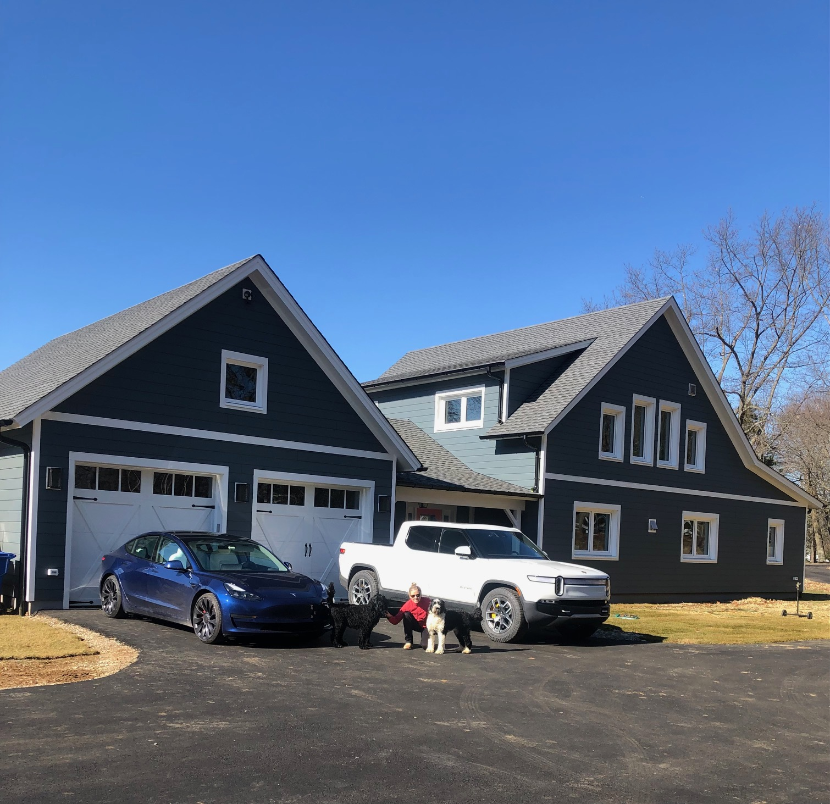
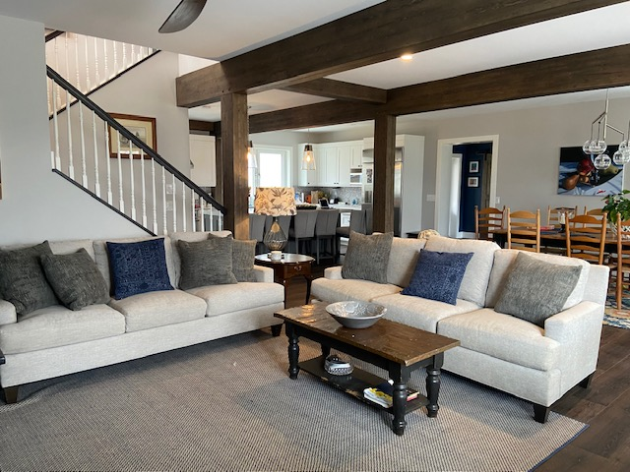
Living in it
We love it!
Feels more solid and quiet than a regular house
Always comfortable. No more thermostat battles
Air quality is great. No dust or humidity

Slide 14
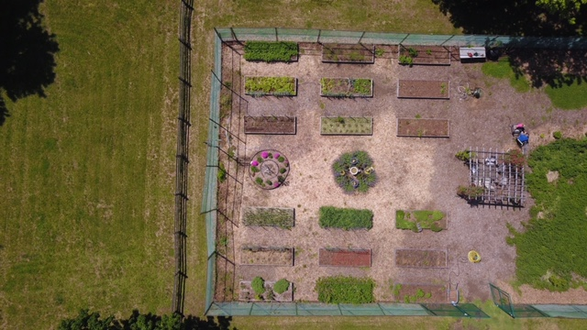
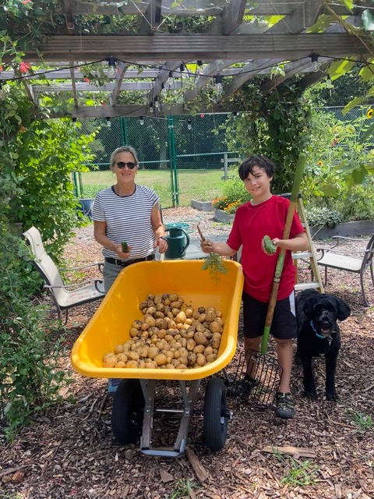
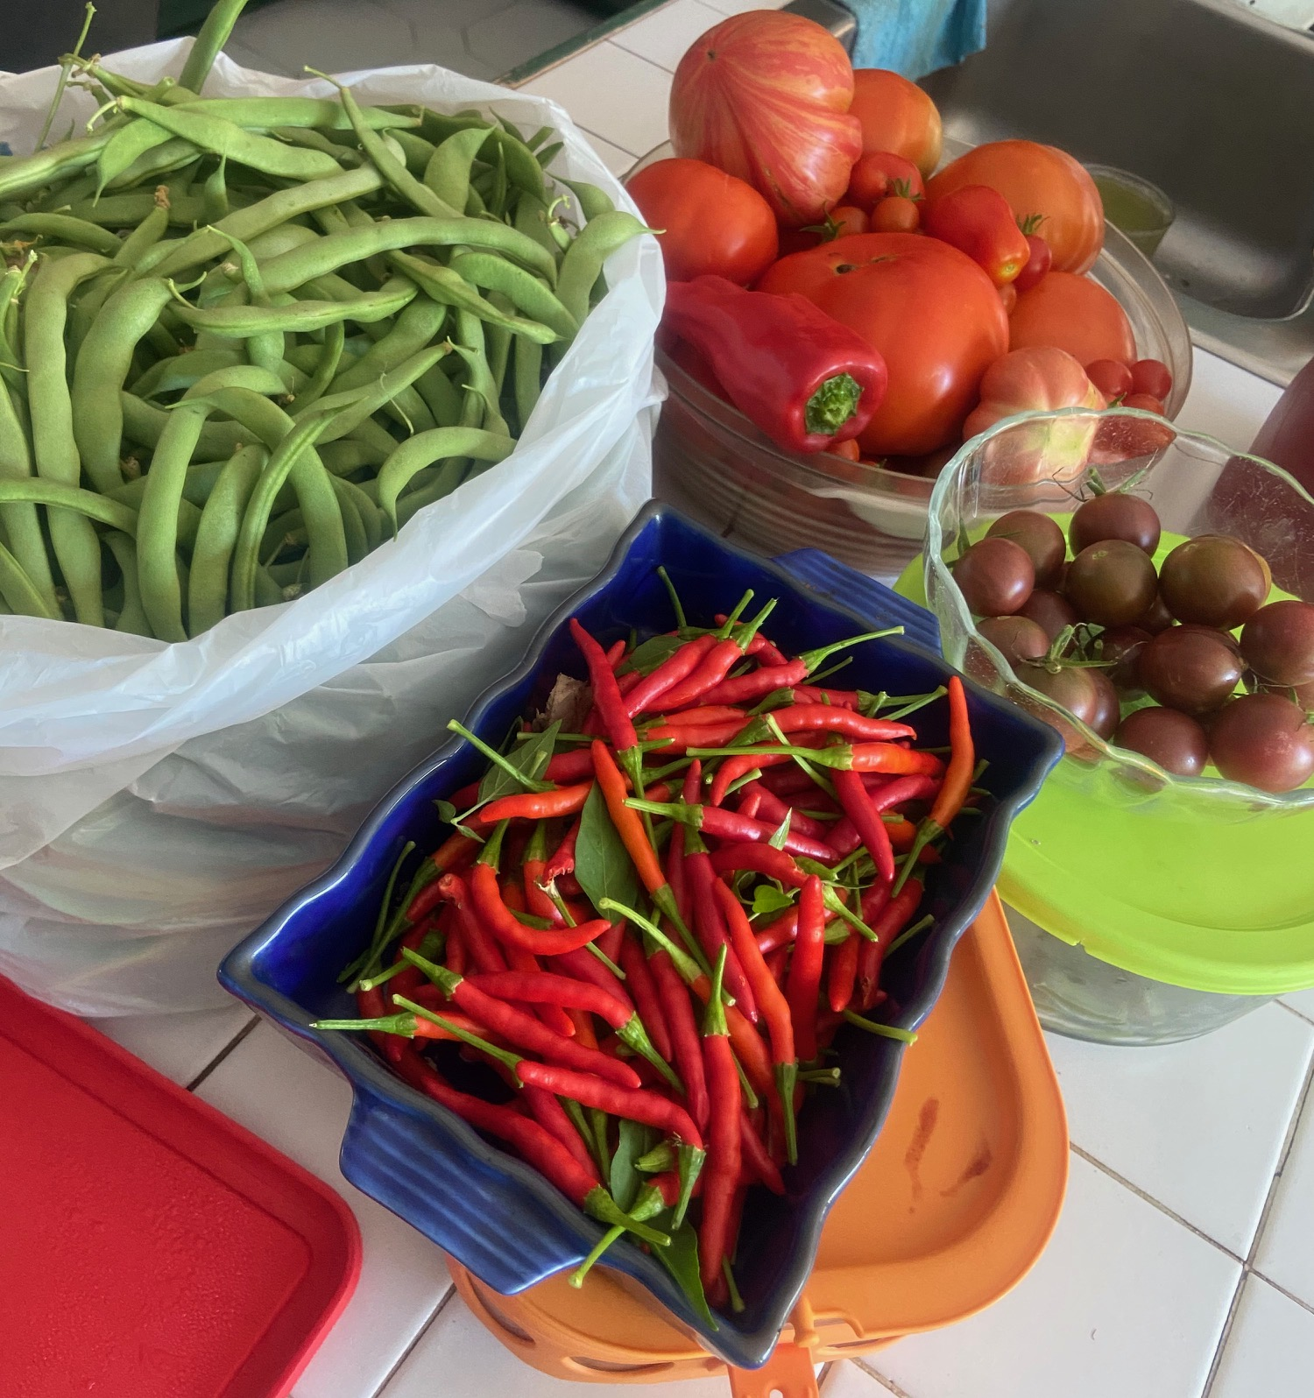
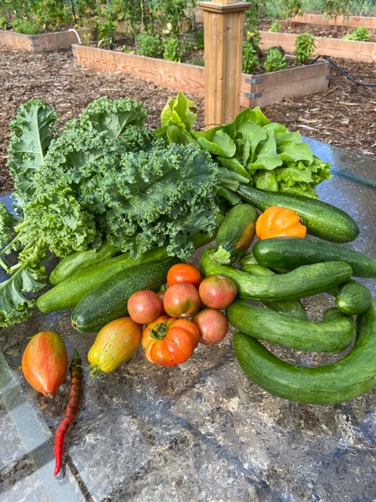
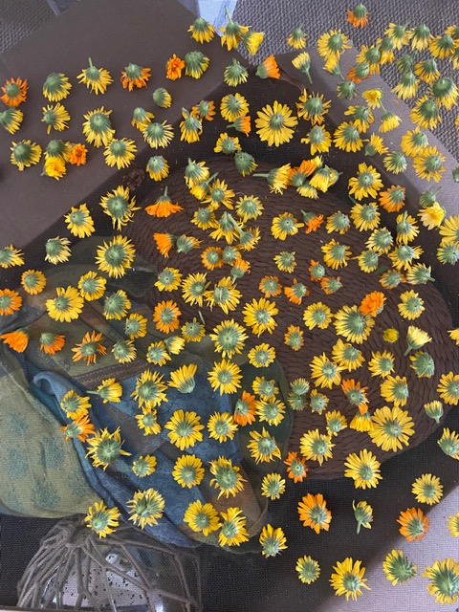
Organic Garden
Organically grown vegetables, fruits, spices, and flowers
No pesticides or fertilizers

Slide 15
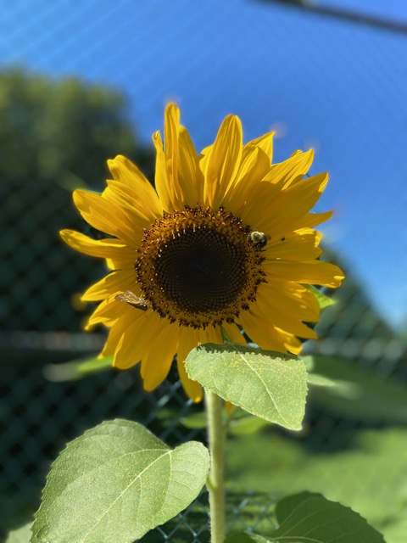
Organic Honey
5 bee colonies
11 acres devoted to supporting Bees
We seed clover annually

Slide 16
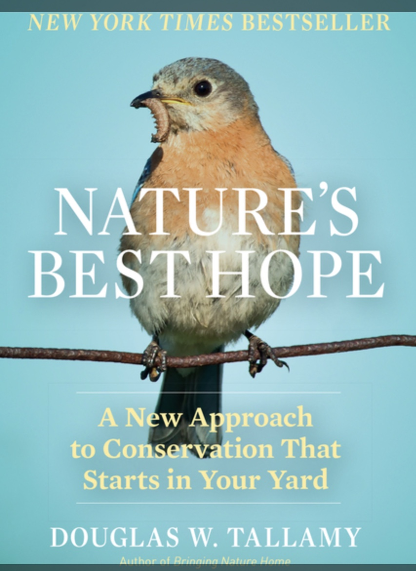
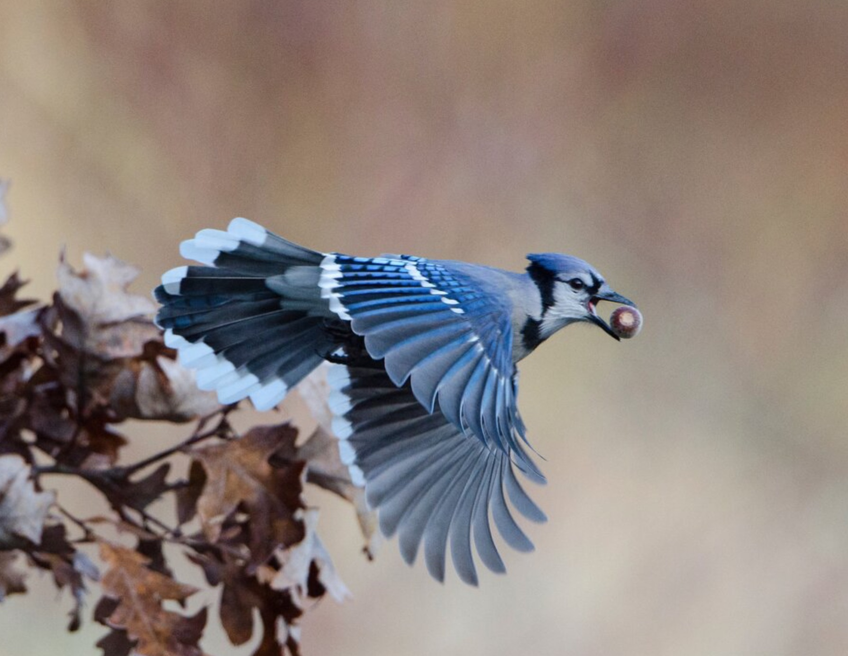
Native Plants
Native plants are important because they provide food and housing for local wildlife
We have Oak, Holly, Beech, Birch, Elm, sunflowers, Milkweed, Echinacea

Slide 17
Thank you
Diane & John Burke| dburke.yoga@gmail.com

